Slide 1
SDC Assignment 3
EKF/UKF fusion

Slide 2
Data
ROS bag from nuScenes dataset.
Play the rosbag by: $ rosbag play sdc_hw3.bag --clock
ROS topics:
/clock (rosgraph_msgs/Clock)
/gps (geometry_msgs/PoseWithCovarianceStamped) ----------------- Simulated GPS (~1Hz)
/gt_odom (nav_msgs/Odometry) ---------------------------------------------------- Ground truth odometry
/imu (sensor_msgs/Imu) --------------------------------------------------------------------------------- IMU
/nuscenes_lidar (sensor_msgs/PointCloud2) ------------------------------------------------------ Lidar pointcloud
/radar_odometry (nav_msgs/Odometry) ------------------------------------------- Odometry calculated by radar
/tf (tf2_msgs/TFMessage) ------------------------------- Transformations between coordinates

Slide 3
Goal
In this assignment, you should learn how to use EKF/UKF to fuse the /radar_odometry and /gps.
Learn the tf in ROS that record the transformation information between different frames. You can use the command:$ rqt to see the TF tree structure.
Radar odometry is the local measurement which have accumulated error.
GPS is the global measurement but only provide x,y position and with only 1Hz.

Slide 4
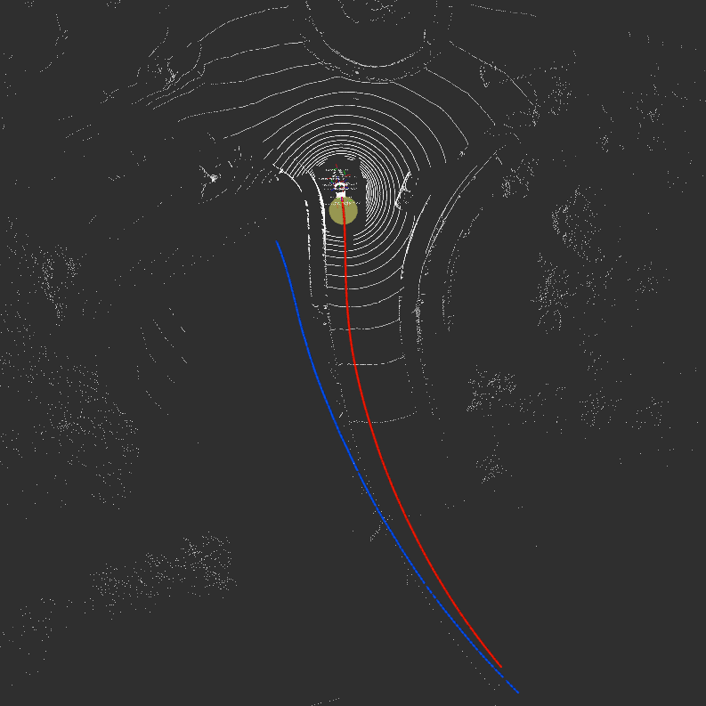
Visualize data in Rviz
You can run Rviz by command: $ rviz
Here is the rviz configuration file for this task.
Open rviz configuration file:
In Rviz -> file -> open config -> YOU_PATH/sdc_ekf_hw.rviz
You should see this when you play the rosbag:
Red arrows: ground truth odometry
Blue arrows: radar odmetry
Yellow circle: GPS
White pointcloud: Lidar pointcloud (not ultilized in this assignment)

Slide 5
ROS - robot_localization package
Github: https://github.com/cra-ros-pkg/robot_localization
Document: robot_localization wiki — robot_localization 2.6.8 documentation
Slide: https://roscon.ros.org/2015/presentations/robot_localization.pdf
Please read following sections to accomplish this assignment.
State Estimation Nodes
Preparing Your Data for Use with robot_localization
Configuring robot_localization
You should set parameters in yaml file as follow:
odom_frame: /origin
base_link_frame: /car
world_frame: /origin
frequency: 10
sensor_timeout: 0.75
two_d_mode: true
transform_time_offset: 0
publish_tf: false
Set <param name="use_sim_time" value="true" /> in your robot_localization launch file.

Slide 6
ROS - robot_localization package
Before you install this package, you need to install the follow the package first
GeographicLib
geographic msg
$ sudo apt-get install ros-melodic-geographic-msgs
What you need to do for this homework?
Modify the setting files of the ekf_template.yaml / ukf_template.yaml
You can use the command below to observe the data when you play the rosbag
$ rostopic echo radar_odometry
$ rostopic echo gps
Modify the config with the ovservation you got
Use the roslaunch to run this program

Slide 7
Assignment - Please follow the steps below:
Download the robot_localization package from the github to your ros workspace folder.
Download the rosbag in page 2.
Read the document and understand how to use robot_localization package.
Use robot_localization package to implement EKF.
You might need to use the roslaunch to run this package and change some settings to input the data to the package.

Slide 8
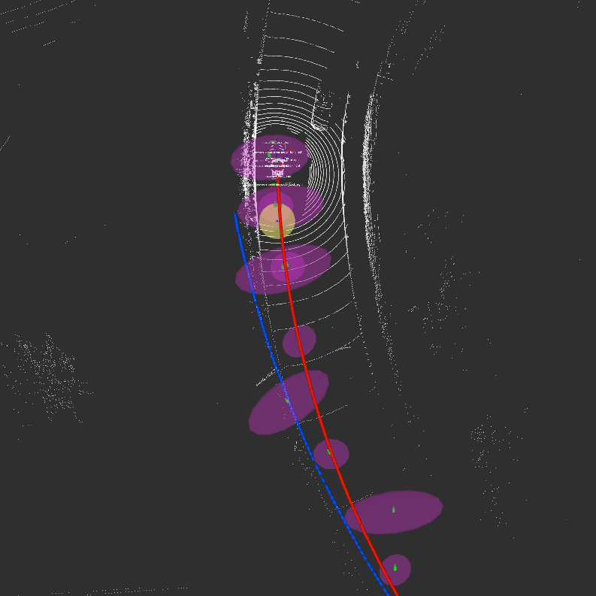
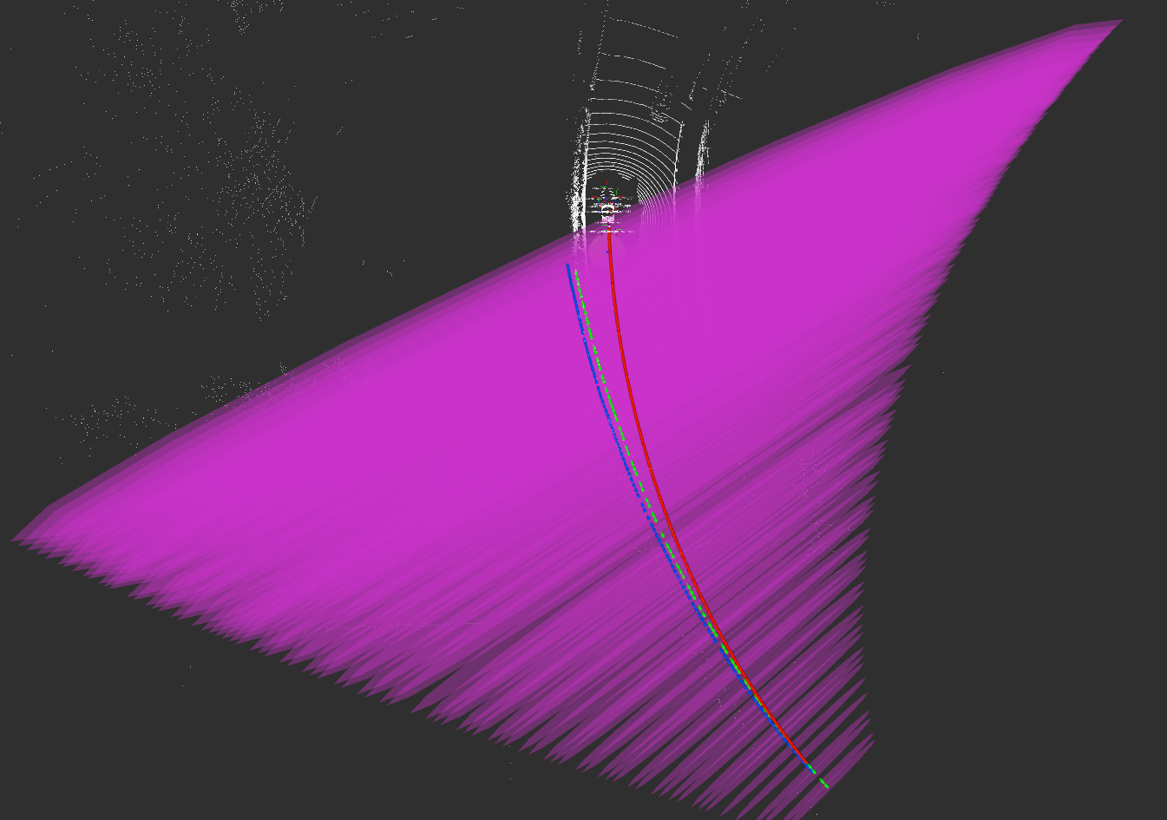
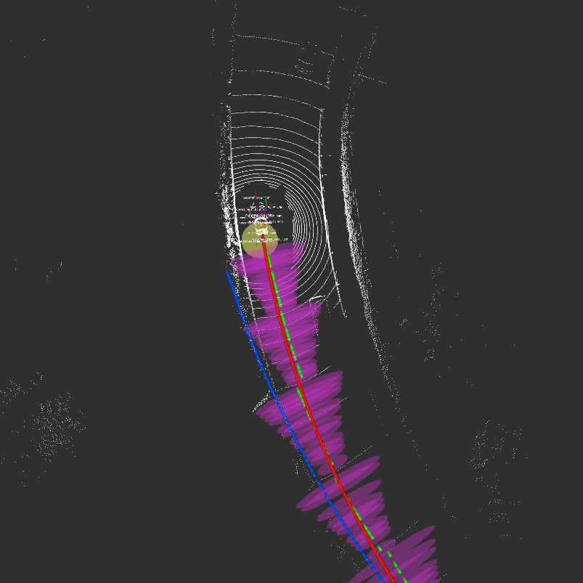
Assignment - Screenshot Result (60%)
Screenshot the result using only GPS in EKF.
Screenshot the result using only radar odemetry in EKF.
Screenshot the result using both GPS and radar odemetry in EKF.
GPS only
radar odometry only
GPS + radar odometry
Green arrows: EKF/UKF result
Purple: covariance of EKF/UKF result

Slide 9
Assignment - Bonus (10%)
Achieve aforementioned task by UKF.
Compare the EKF result with the UKF result, describe your findings, and explain why.

Slide 10
Assignment - Question Discussion (40%)
How do robot_localization package know the covariance matrix of GPS and radar odometry?
What is the covariance matrix of GPS and what does it mean?
In yaml file, you set differential parameter of odometry and GPS to true or false? Why?

Slide 11
Submission
A PDF file include your screenshot and answer of the questions.
Read the report (kalman_intro.pdf) and submit a report summarizing the paper to the PDF file.
Your robot_localization setting files (.yaml)
Compress the files and name it as <student_id>_hw3.zip
Deadline: 2020/10/27 Tue 00:00

Slide 12
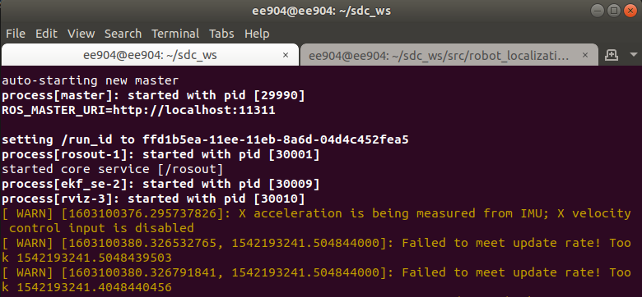
Q&A
What is the data we need to use?
The rosbag can be download from the link at the this page.
Do I need to build a package by myself?
No, You can just use the robot_localization package we introduce on this page.
If you encounter the WARN below, you can skip this and it would not cause any probelm.

Slide 13
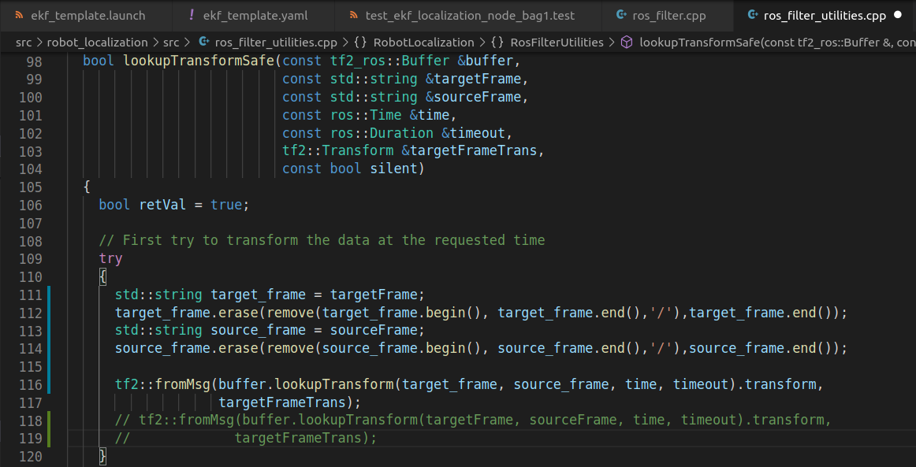
Q&A
4. If you get the error that tf2 get invalid value that frame_id cannot contain “/”, you can add some code below into ros_filter_utilities.cpp to avoid this problem:

Slide 14
Q&A
std::string target_frame = targetFrame;
target_frame.erase(remove(target_frame.begin(), target_frame.end(),'/'),target_frame.end());
std::string source_frame = sourceFrame;
source_frame.erase(remove(source_frame.begin(), source_frame.end(),'/'),source_frame.end());
tf2::fromMsg(buffer.lookupTransform(target_frame, source_frame, time, timeout).transform,targetFrameTrans);

